Slide 1

Azure Fundamentals SQL, App Service, Container
Clemens Siebler Cloud Solution Architect @clemenssiebler

Slide 2
Azure Database Services
SQL Databases
CosmosDB

Slide 3
Putting Azure SQL Database into Numbers
4.1million
databases
154PB total size
421K subscriptions
3Trillion batch requests/day
1.4 million HTAP transactions/sec
100million queries analyzed/hour
Notes:
https://docs.microsoft.com/en-us/azure/sql-database/sql-database-paas-vs-sql-server-iaas

Slide 4
Migration to Azure SQL
SQL Server Migration Assistant (SSMA)
Automates database migration to SQL Server from Microsoft Access, DB2, MySQL, Oracle, and SAP ASE.
Data Migration Assistant (DMA)
Enables upgrade to SQL Server and Azure SQL Database.
Database Experimentation Assistant (DEA)
Assists in evaluating a targeted version of SQL for a given workload.
Azure Hybrid Benefit for SQL Server
Maximizes current on-premises license investments to facilitate migration.
Azure SQL Database Managed Instance
Facilitates lift and shift migration from on-premises SQL Server to PaaS.
SQL Database Managed Instance
Azure Database Migration Service (Azure DMS)
SQL Server Migration Assistant (SSMA)
Data Migration Assistant (DMA)
Database Experimentation Assistant (DEA)
Azure Hybrid Benefit for SQL Server

Slide 5



Azure Cosmos DB
A globally distributed, massively scalable, multi-model database service
Table API
MongoDB
SQL
Key-value
Column-family
Document
Graph
Guaranteed low latency at the 99th percentile
Elastic scale out
of storage & throughput
Five well-defined consistency models
Turnkey global distribution
Comprehensive SLAs

Slide 6
Azure App Service
Web Apps from VS
Integration with GitHub

Slide 7
Innovation
Value to business
PaaS
Efficiency
IaaS
Time

Slide 8
Azure App Service
Quickly build, deploy and scale powerful cloud applications without worrying about infrastructure
High productivity
.NET, Node, Java, Docker, PHP, Ruby, Python
Staging & deployment
Testing in production
App gallery marketplace
Fully managed
Auto scale & load balancing
High availability w/ auto patching
Reduced operations costs
Backup & recovery
Enterprise grade
Global data center footprint
Hybrid support
AAD integration
Secure & compliance

Slide 9
Linux Containers on Azure
Azure Kubernetes Service (AKS)
Azure Container Registry (ACR)
Azure Container Instances (ACI)

Slide 10
What is a container?
Traditional virtual machines = hardware virtualization
Containers = operating system virtualization
Application
VM
VM
VM
OS
Applications
Container
Container
Container
App
App
App
OS
OS
OS
OS
Kernel
Hardware
Hardware

Slide 11
Virtualization versus containerization
Virtual machine
Container
Application
Application XYZ
Dependencies
App dependencies
Guest OS
C
C
C
C
C
VM
VM
VM
Dependency 1
Dependency 2
Hypervisor
Container Engine (e.g., Docker)
Host OS
Host OS
Hardware
Hardware
Virtualization
Containerization

Slide 12
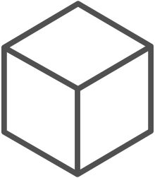
The container advantage
Fast iteration
Agile delivery
Immutability
Cost savings
Efficient deployment
Elastic bursting
For developers
For IT

Slide 13
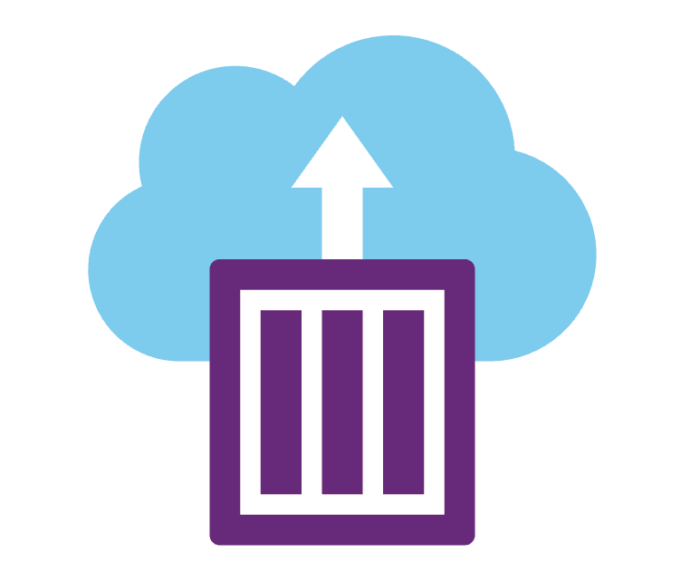

Azure container ecosystem
Azure Kubernetes Services (AKS)
Azure Container Instances
Azure Service Fabric
Azure App Service
Infrastructure Control
Developer productivity

Slide 14

Partner Technical (Presales) Support depts@microsoft.com

Slide 15
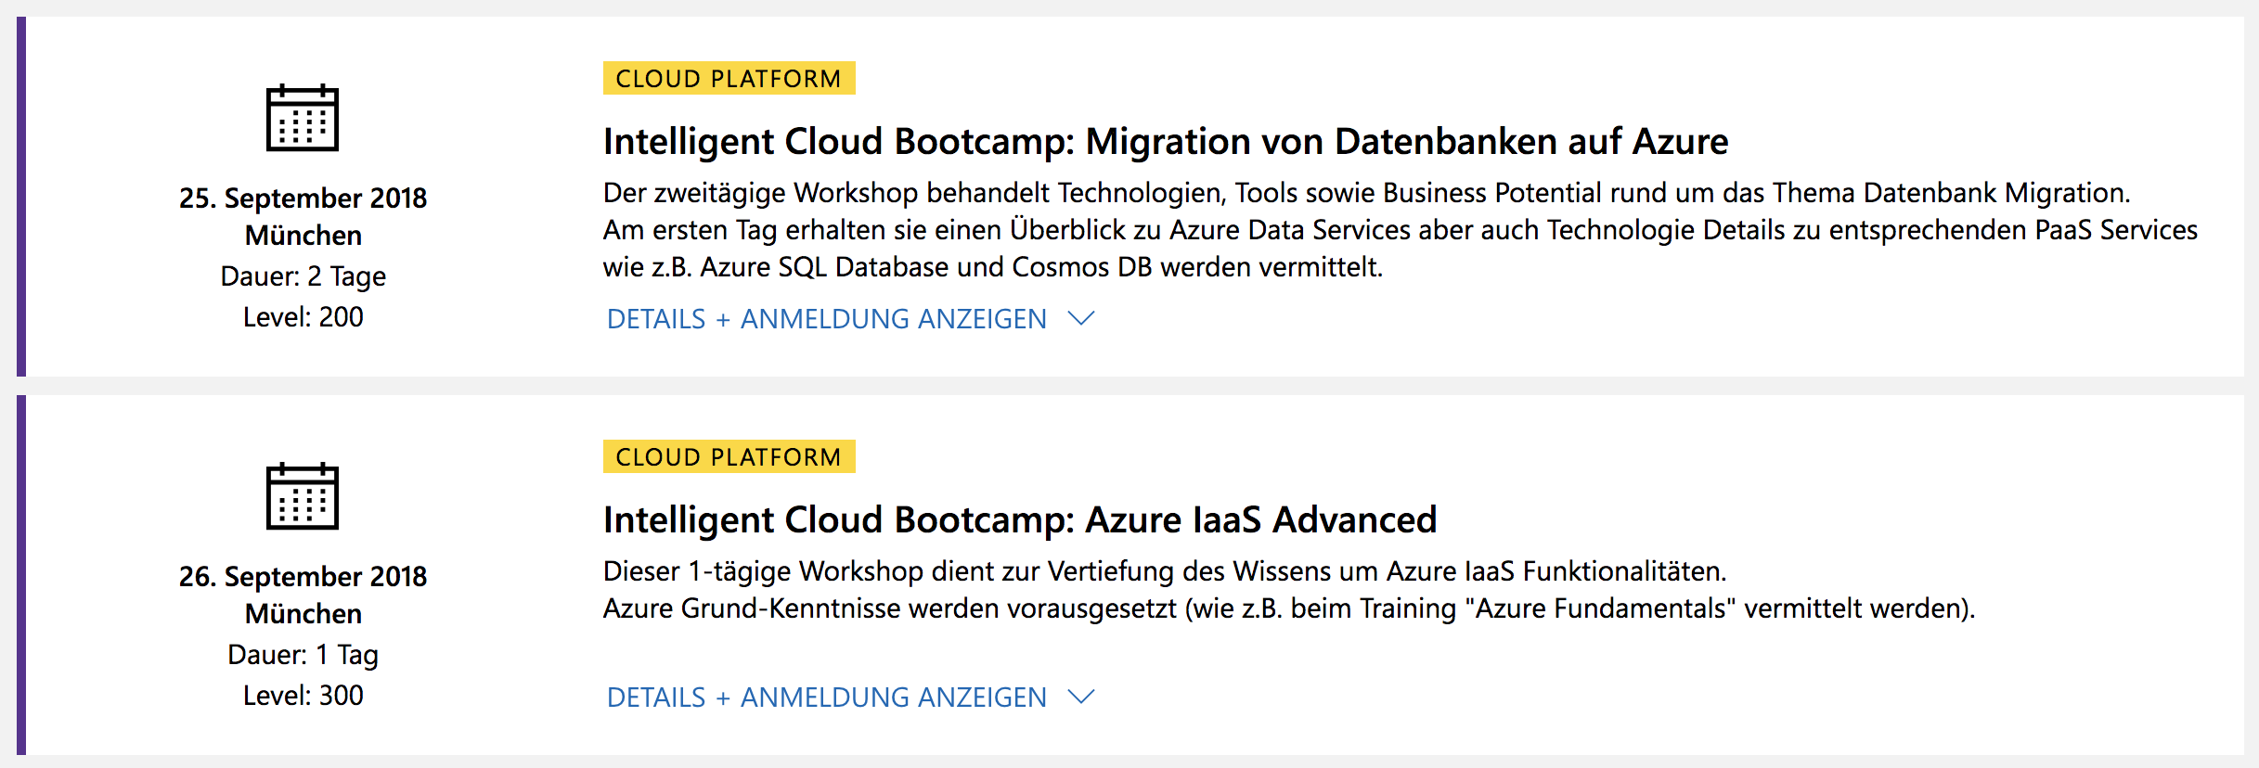
https://aka.ms/mehr-wissen
…und viele mehr!

Slide 16
Next Steps aka.ms/azurequickstart

